Slide 2

Creating iOS & Android apps
in .NET Using Xamarin

Slide 3

Xamarin
iOS C# UI
Android C# UI
Windows C# UI
Shared C# Logic
Shared C# codebase • 100% native API access • High performance

Slide 4


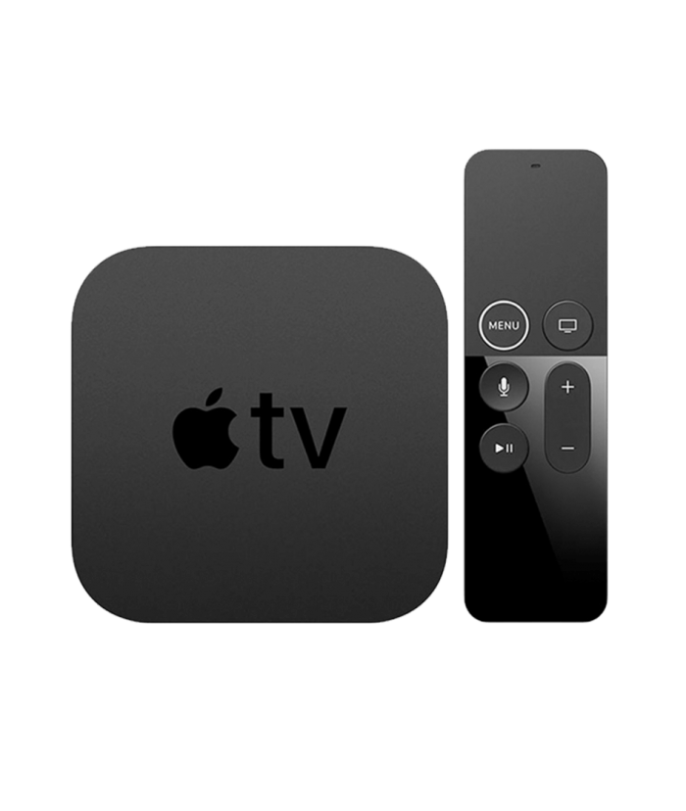

Xamarin
iOS C#
Android C#
Windows C#
Shared C# Logic
3 Native User Interfaces
Shared App Logic

Slide 5
Everything you can do
in Objective-C, Swift, Java or Kotlin
can be done in C# with Xamarin

Slide 6

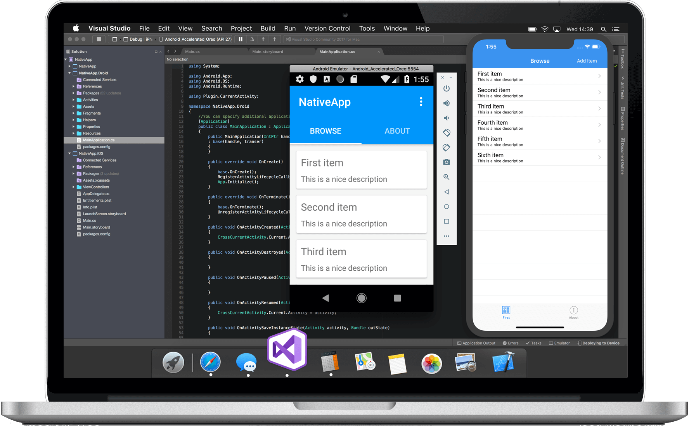
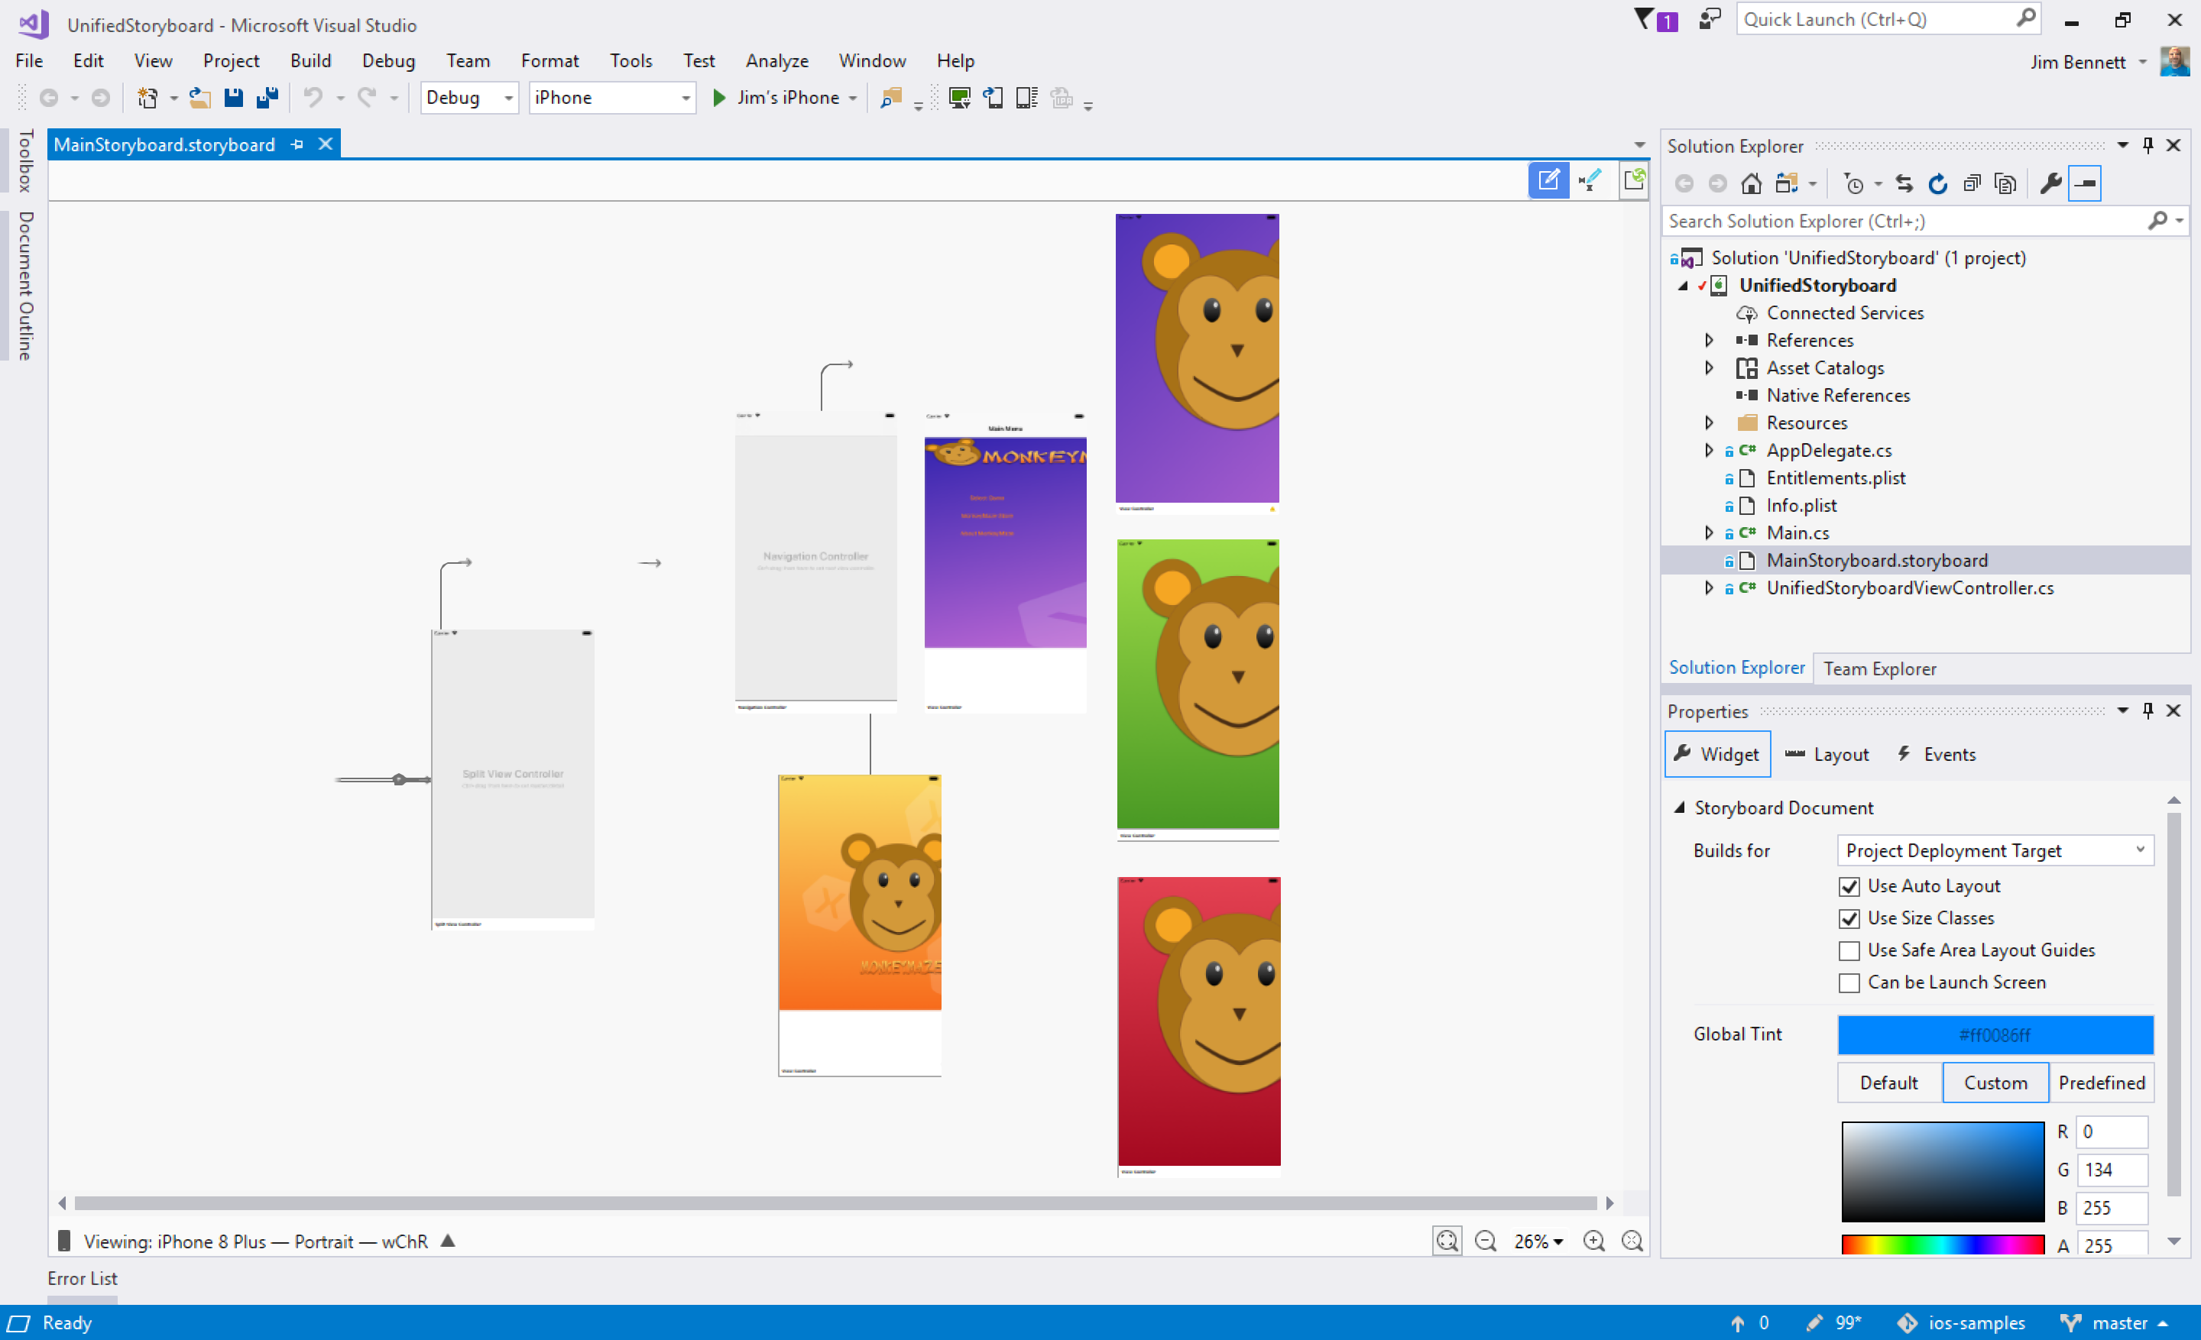
Visual Studio (PC)
Visual Studio for Mac

Slide 7

Open Source
+

Slide 8
Sharing User Interface

Slide 9
Xamarin
+ Xamarin.Forms
iOS C# UI
Android C# UI
Windows C# UI
Xamarin.Forms
Shared C# Logic
Shared C# Logic
Traditional Xamarin approach
With Xamarin.Forms: More code-sharing, all native

Slide 10
Quick Review

Slide 11
Xamarin
Native Mobile Apps in .NET
Create native iOS apps
Create native Android apps
Xamarin.Forms
Share UI Code
Visual Studio
Develop in Visual Studio (PC)
Develop in Visual Studio for Mac

Slide 13
Presentation Slide

Slide 15
Demo intro slide

Slide 16
Code Sample Title

